Slide 1
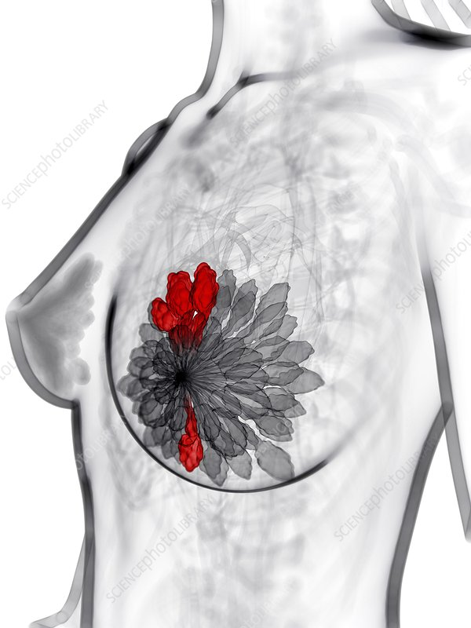
Classification Model for Prognosis of Breast Cancer
Dialog Data Science Academy – Machine Learning Foundation Capstone
By: Yasiru Makavita
2021.11.27

Slide 2








Content
Use case
Dataset
Data Cleaning
Data Balancing
Feature Selection
Model Selection
Model Tuning
Finalization and conclusion

Slide 3
Use Case
After a cancer patient has been cured, there is a chance that the cancer might recur.
Periodic checkups must be done to identify if cancer has recurred or not.
Every cured patient does not continue this testing process due to several reasons and it is too late when the recurred cancer is detected.
If a system can be developed to predict of the patient has a chance of recurring cancer, they can keep aware and take the necessary precautions.
Also the patients who do not have the risk of recurrence can save the time, money spent for testing and reduce the mental stress worrying about recurrence.
This project is focused on developing a ML model to predict if the cancer can be recurred or not based on past cancer details.

Slide 4
Dataset
Dataset was taken from UCI machine learning repository and the Data was collected by Dr. Wolberg on 197 cancer patients seen by him since 1984
It only includes data of patients who were exhibiting invasive breast cancer and no evidence of distant metastases at the time of diagnosis .
Dataset includes:
If the case is recurrent or not
Time for recurrence / cancer free time if non recurrence
30 parameters of a nucleus of a cell of the previous cancer
Size of the previous tumor
Number of positive axillary lymph nodes observed at time of surgery
The 30 parameter features are computed from a digitized image of a fine needle aspirate (FNA) of a breast mass.

Slide 5






Development environment and tools
Environment : Google Colab
Language : Python
Libraries used

Slide 6
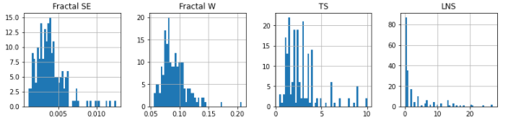
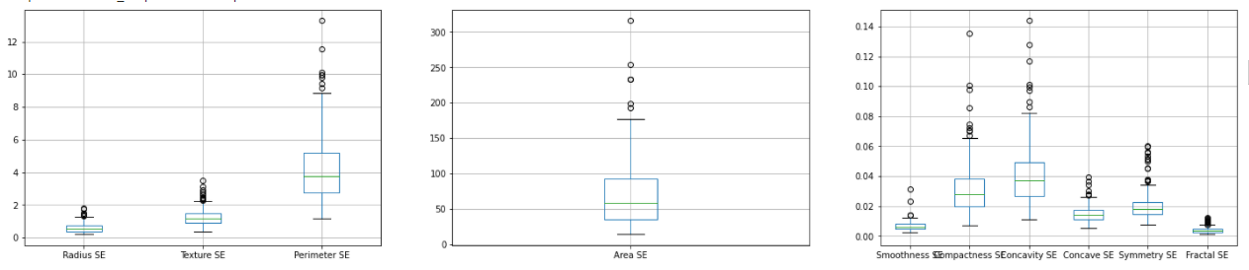
Pre processing
Labeling was done since data frame did not contain column names.
Dataset was scanned for missing values and removed the detected 4 missing values.
Categorical variables were converted into numerical variables.
Histograms and box plots were used to understand the behavior of data.
5. Dataset had an uneven distribution with lot of outliers. Due to large number of outliers, removing them reduced the dataset where minority class (Y variable) was very small.
Therefore, it was decided not to remove the outliers. Unpredictable behavior of cancer cell must have caused the above.
6. To balance the dataset, majority class of Y variable was under sampled by randomly removing values until it was equal to the minority class.

Slide 7
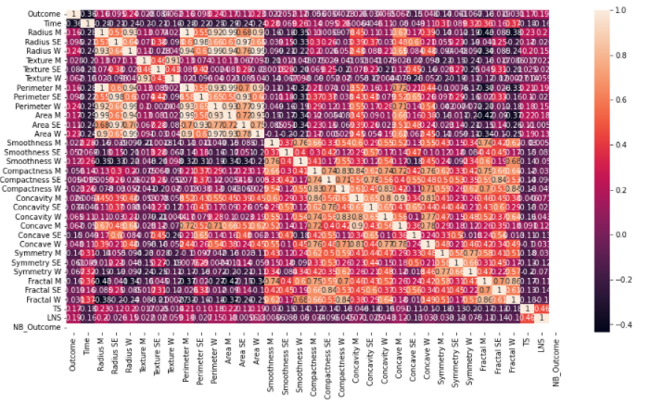
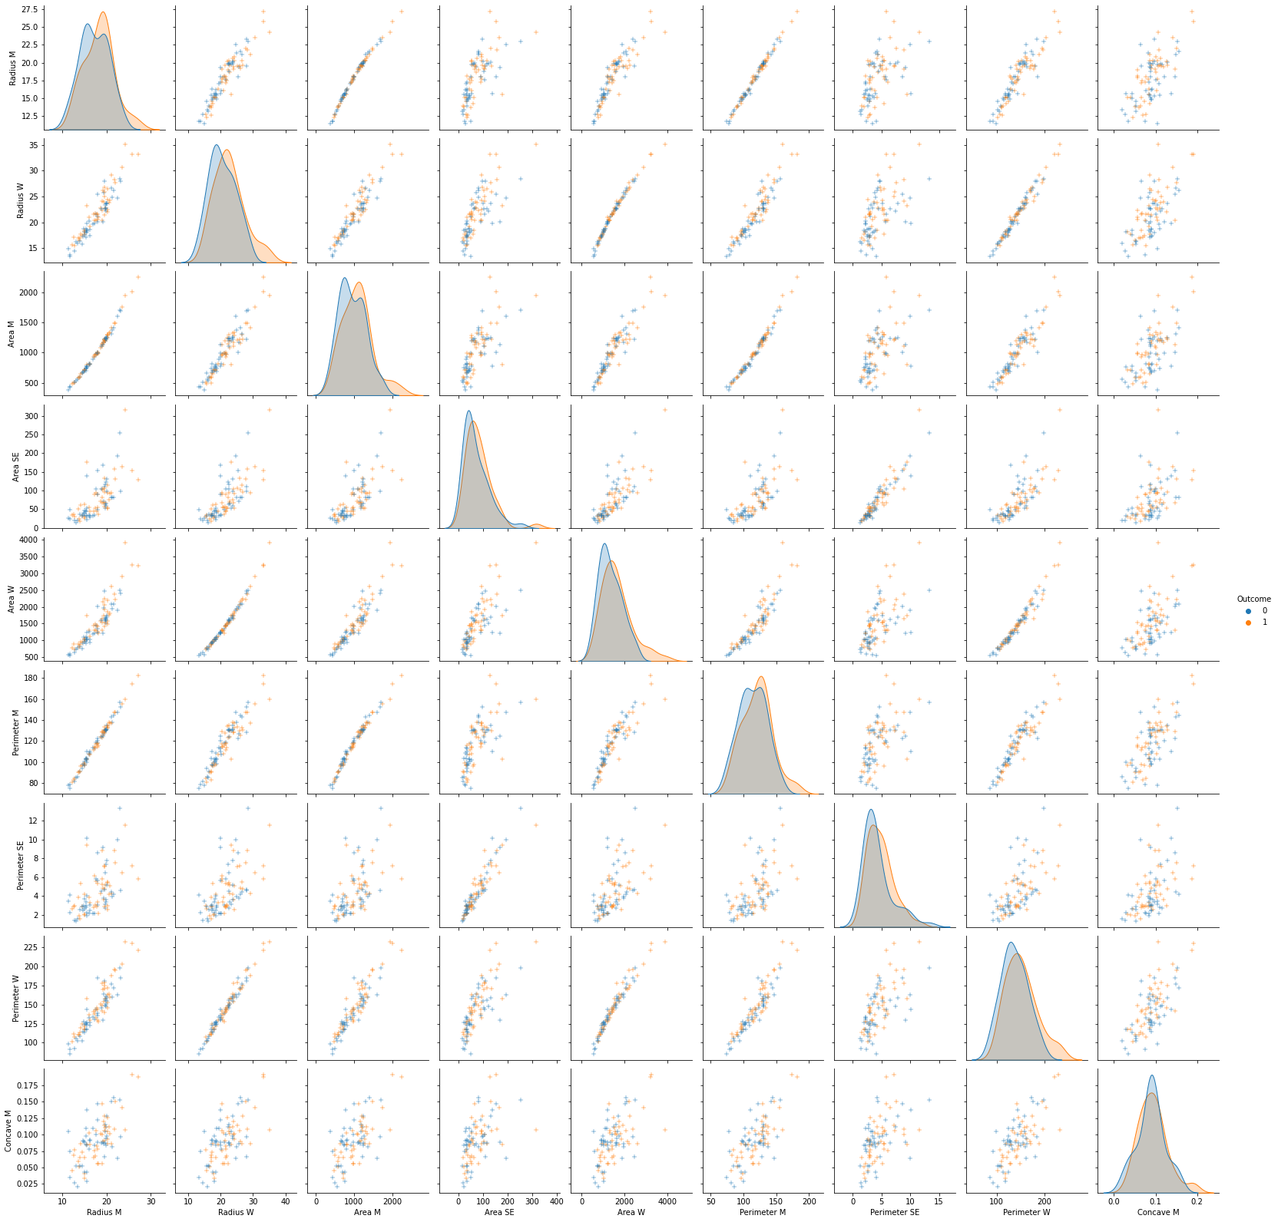
Feature selection
Correlation matric and pair plot was used to select the features
Features with the highest correlation with the ‘Y variable’ were selected
Correlation between those features were inspected and highly corelated features were grouped.
One feature each was selected from those groups, based on the correlation value to the y variable
Mean Area, Mean Concave, Area Standard Error & Worst Perimeter were selected as the features

Slide 8
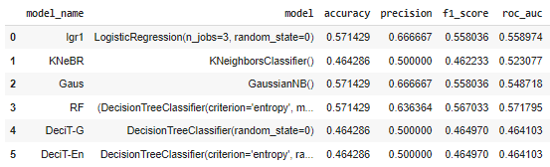
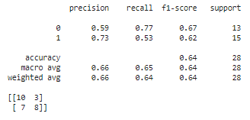
Model selection & Tuning
5 ML classification models were selected for testing. Function for training and scoring models was created.
Logistic Regression
Decision Tree
Random Forest
GaussianNB
KNeighbours
Dataset was split into test (30%) and train (70%) sets.
Each model was passed through the above function and got scored. 4 scoring matrices were used.
Accuracy
Precision
F1 Score
ROC_AUC
Logistic Regression was selected as the best model its hyper parameters were tuned using grid search method.

Slide 9

Saving the best model
Model was scored using a sample dataset
Best trained logistic regression model was saved using pickle.

Slide 10
Conclusion
Model has a true positive rate of 62.5% and true negative rate of 83.4%.
Therefore the model accurately predicts negatives cases than positive case.
It was identified that randomly removing values to balance the dataset can affect the scores of the model.
Above fact shows that selected 4 features must be cleaned (remove outliers and standardize) before balancing the dataset.
Even though the model isn’t super accurate, it had achieved the objective by predicting cancer recurrence. Further tuning is needed before deployment.
END

